Slide 1
ARGOS Threat Detection Watchdog Device
Implementation
Embedded Systems
Hugo Carvalho – A85156
José Mendes – A85951

Slide 2
Agenda
Problem Statement
System Overview
Analysis
Design
Implementation
Testing
Gantt Diagram

Slide 3
Problem Statement
The product aims to help identify and report threats resorting to a weapon recognition system powered by computer vision.

Slide 4
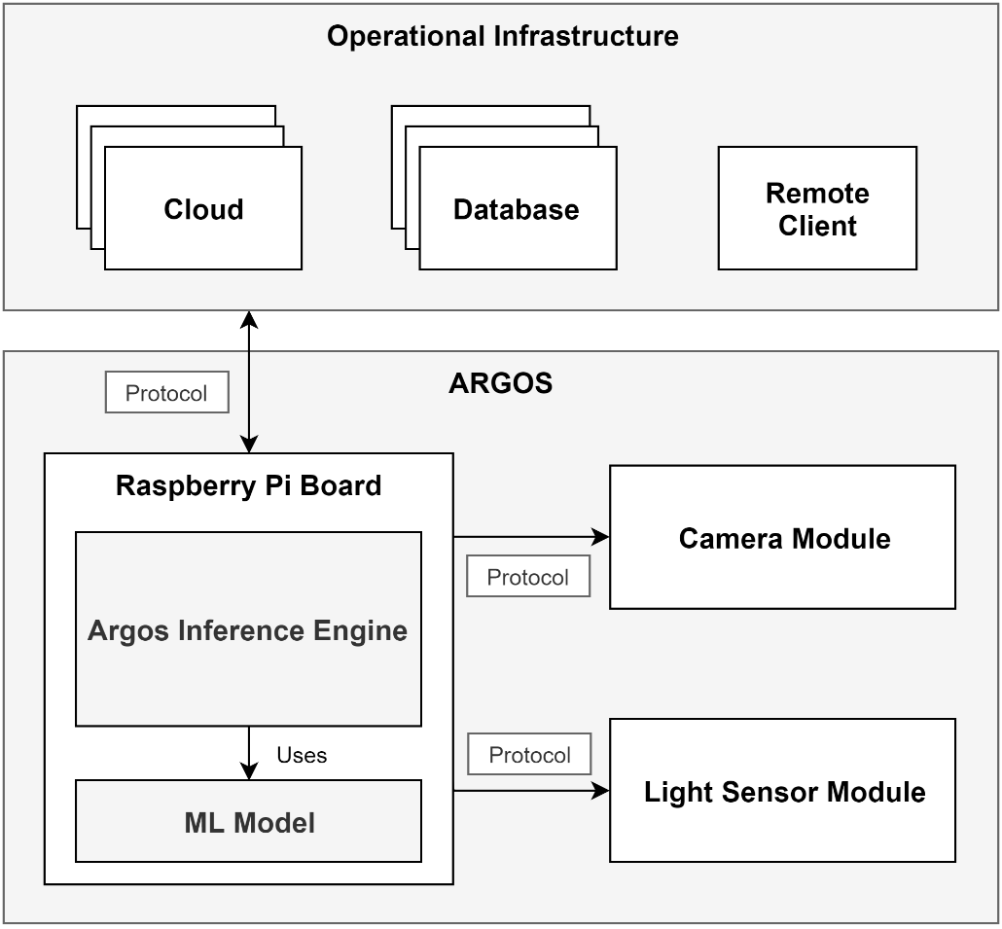
System Overview

Slide 5
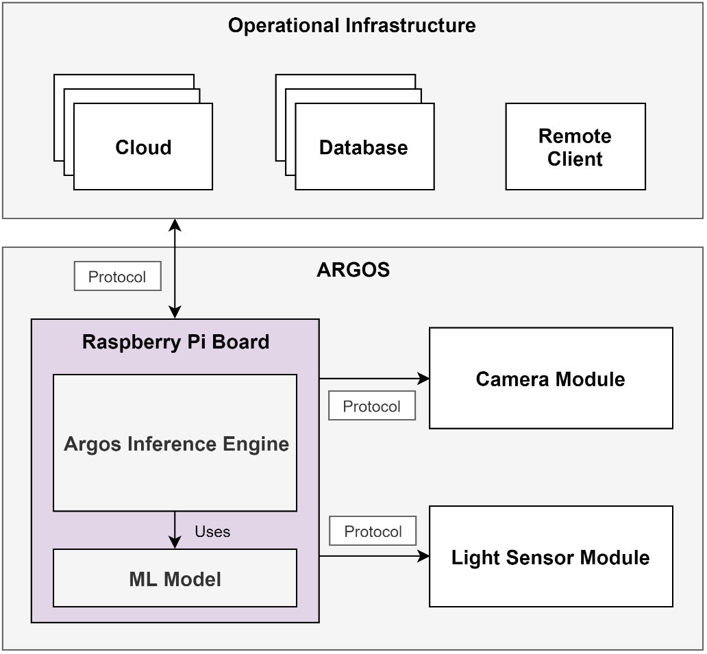
System Overview

Slide 6
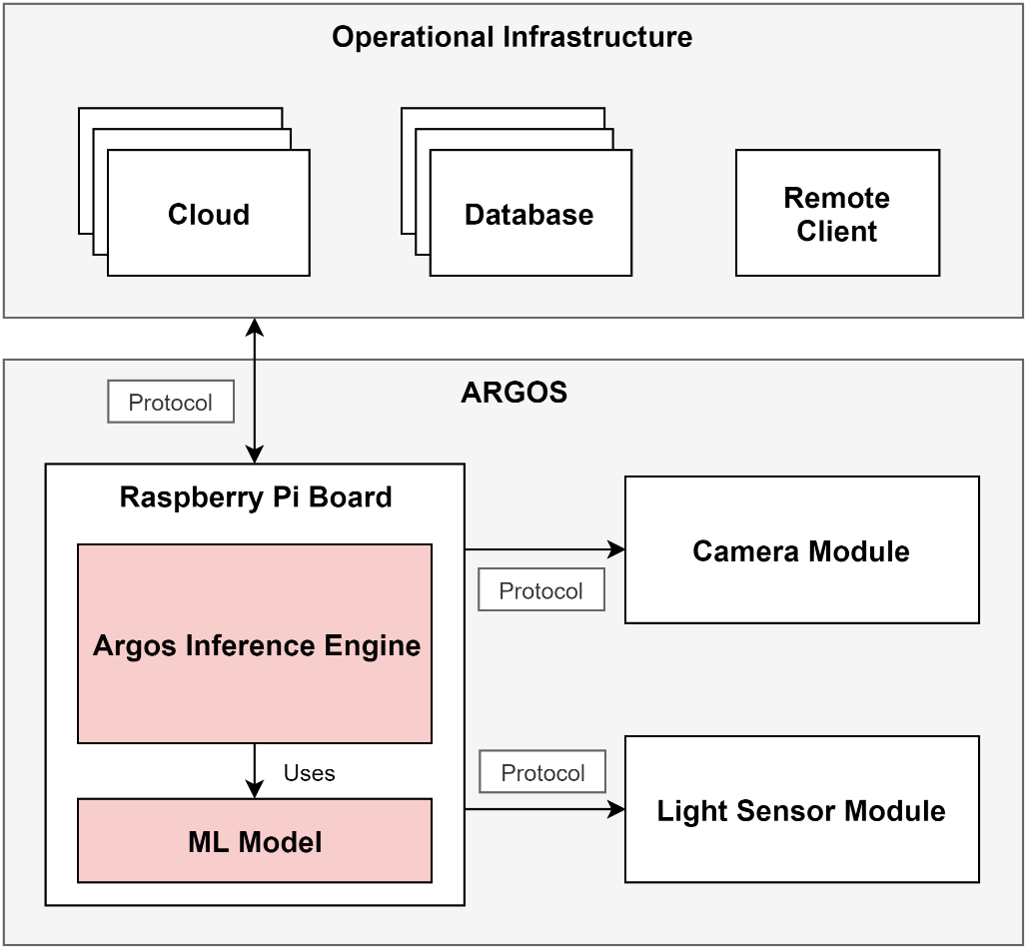
System Overview

Slide 7
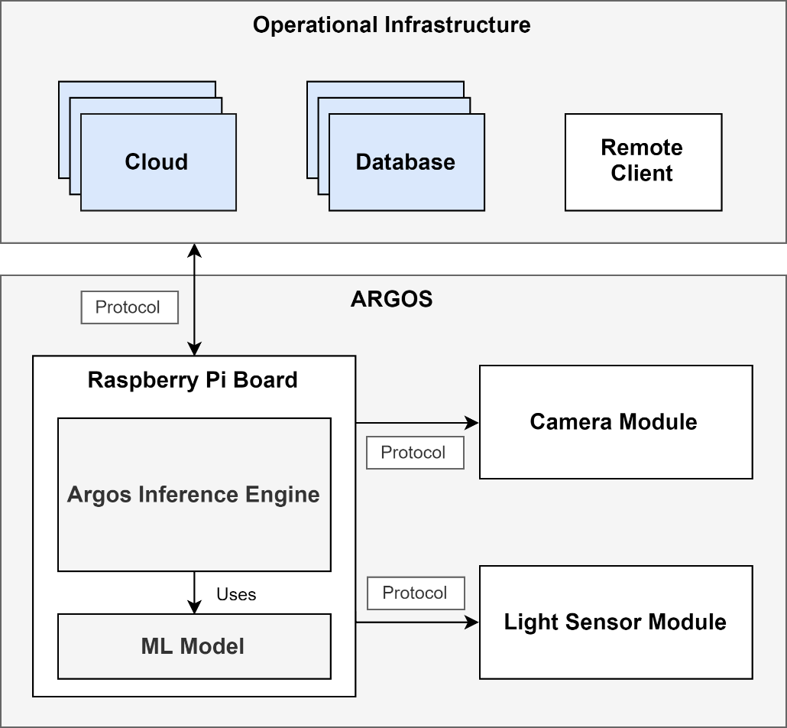
System Overview

Slide 8
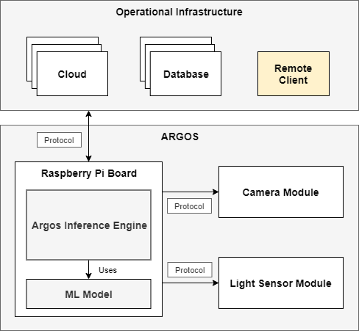
System Overview

Slide 9
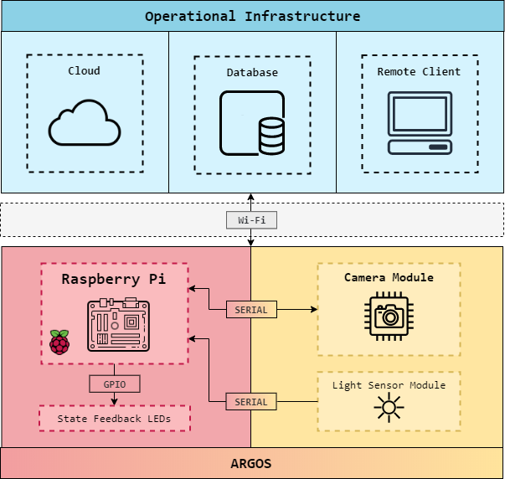
Hardware Architecture

Slide 10
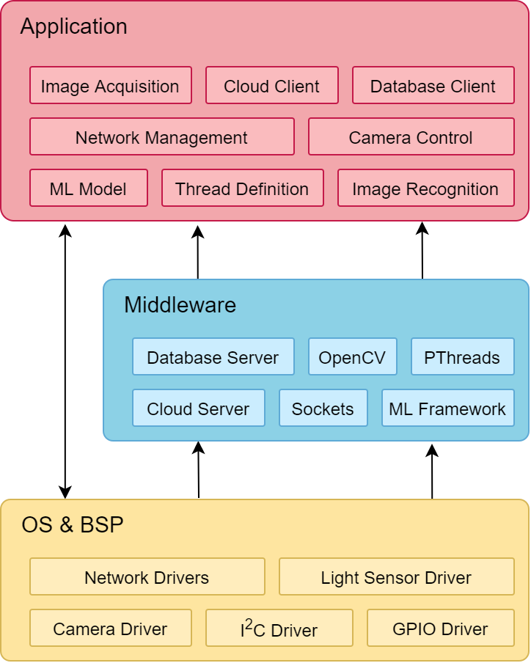
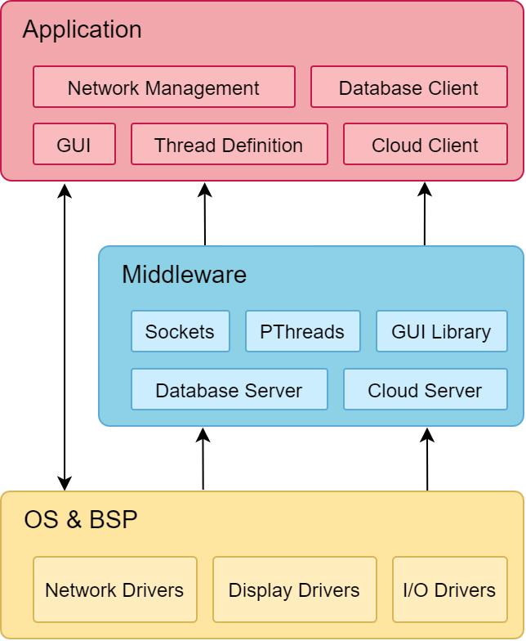
Software Architecture
Computational Unit
Remote Client

Slide 11
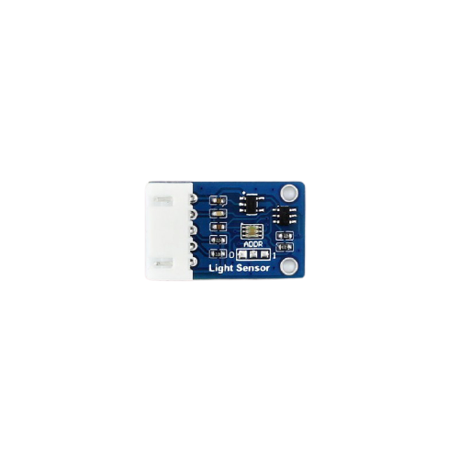
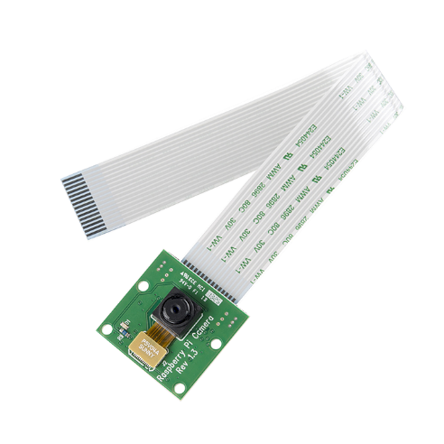
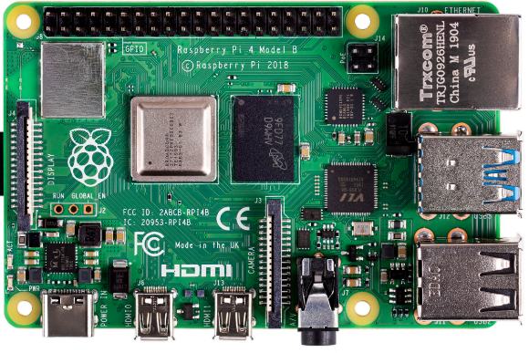
Hardware Specification: Computational Unit
Raspberry Pi 4B
TSL2581 (light sensor)
Raspberry Cam

Slide 12
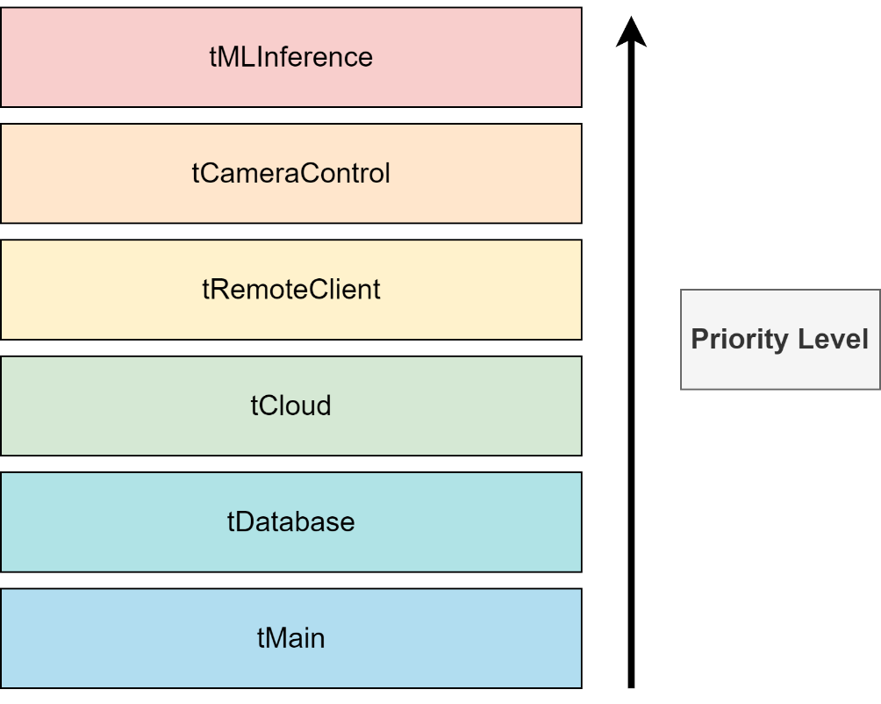
Software Specification: Thread Priority

Slide 13
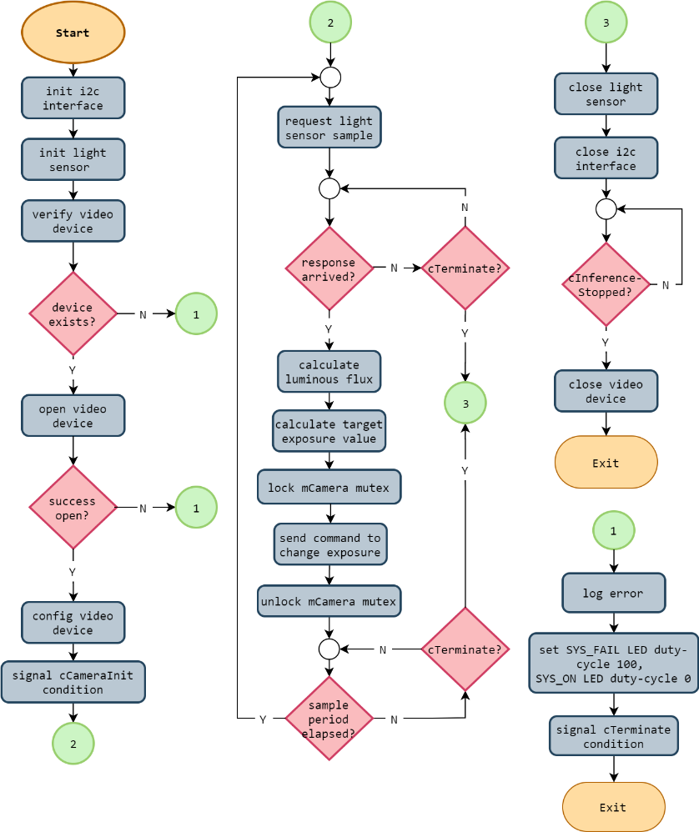
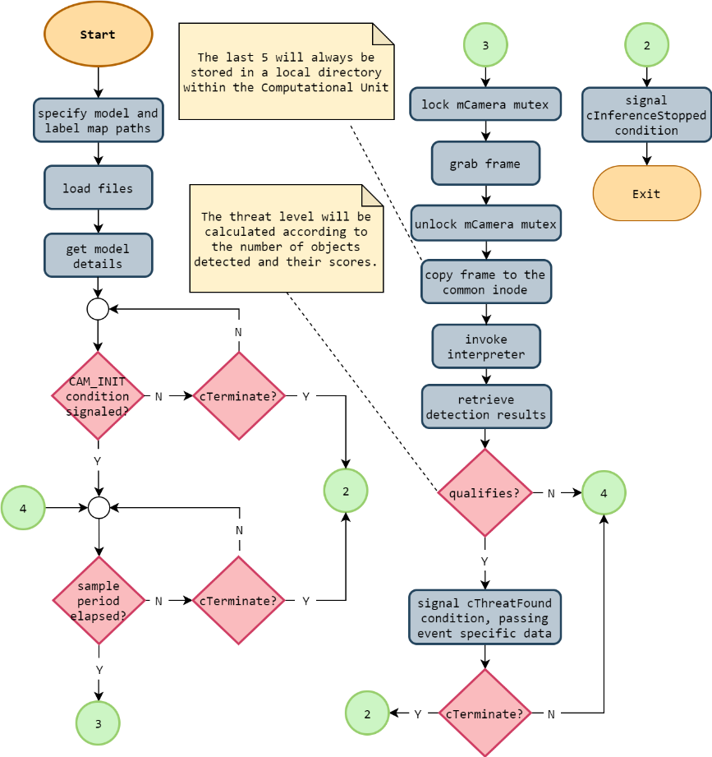
Software Specification: Comp. Unit Threads
tCameraControl
tMLInference

Slide 14
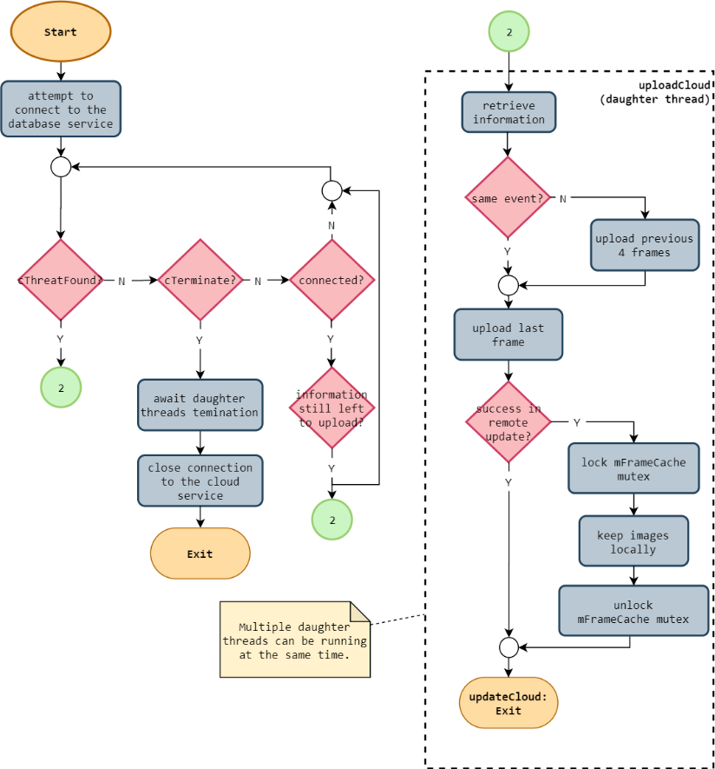
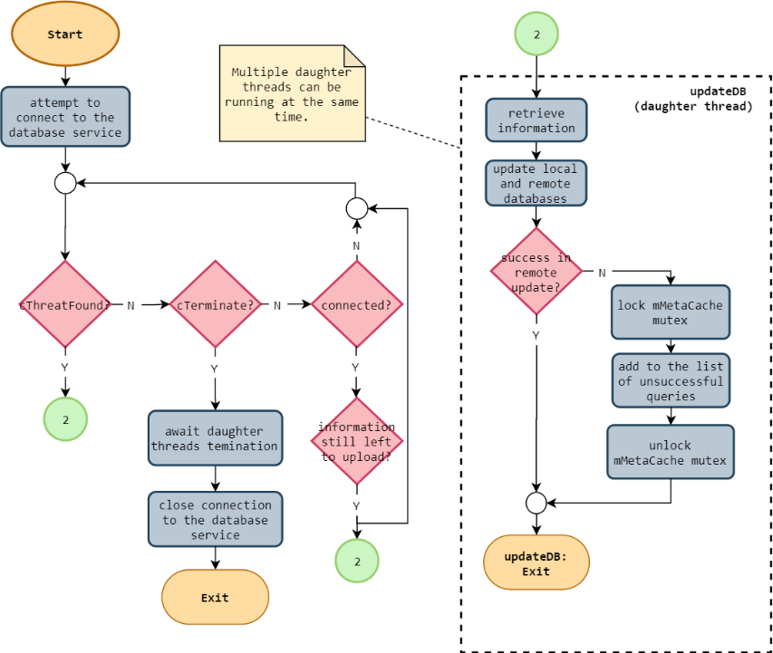
Software Specification: Comp. Unit Threads
tMain
tDatabase

Slide 15
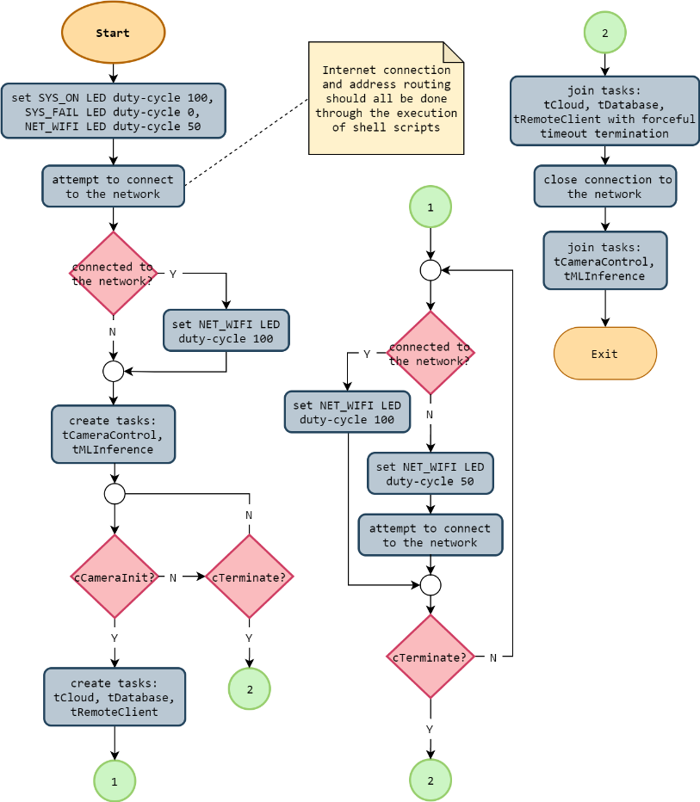
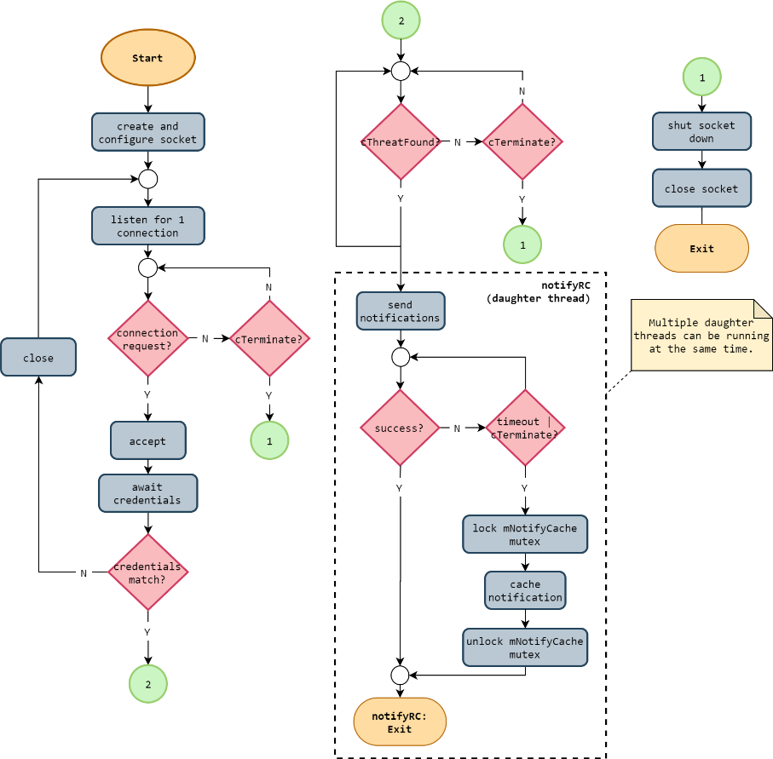
Software Specification: Comp. Unit Threads
tCloud
tRemoteClient

Slide 16
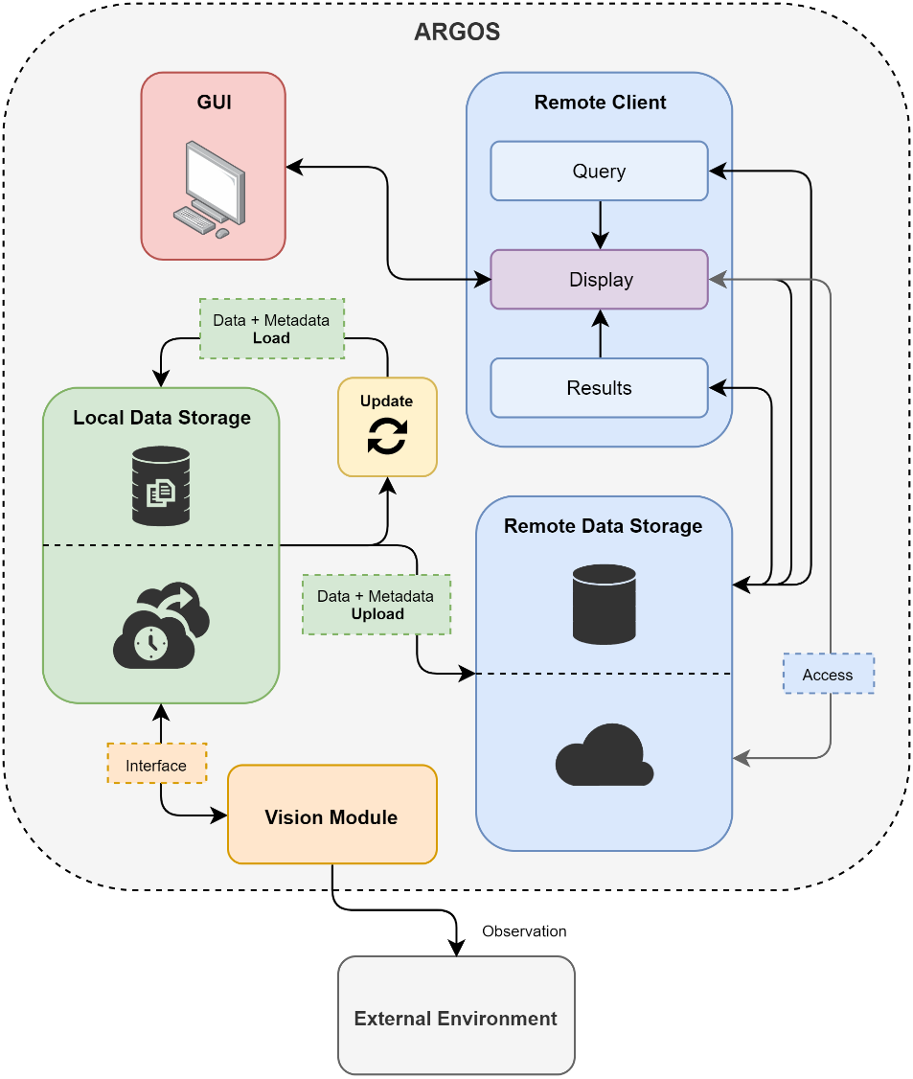
Envisioned Storage Framework

Slide 17
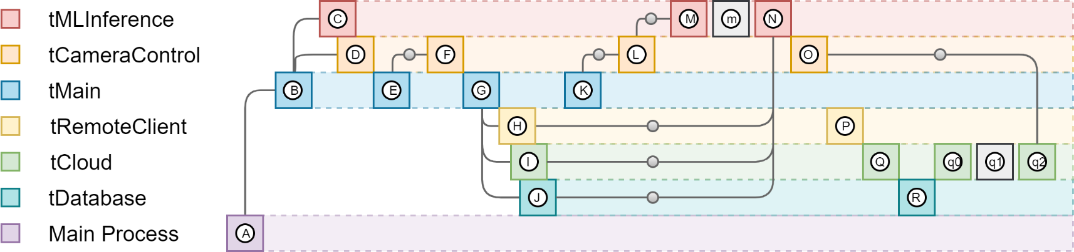
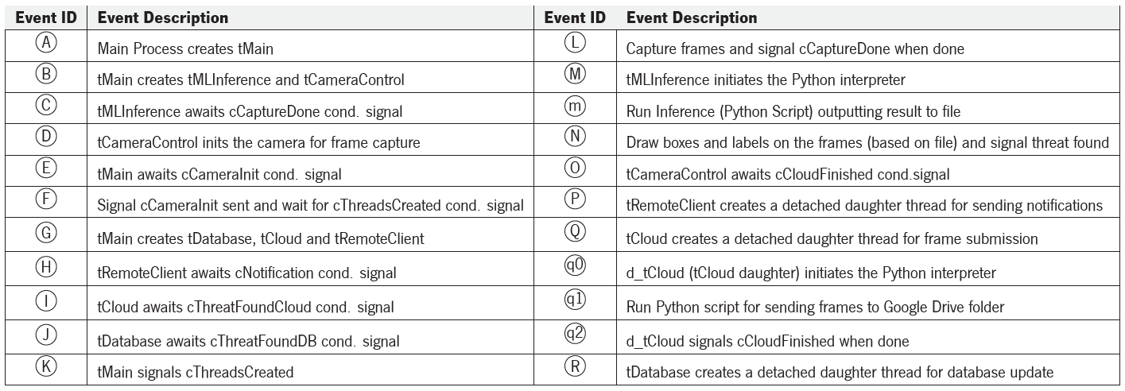
Thread Timeline

Slide 18
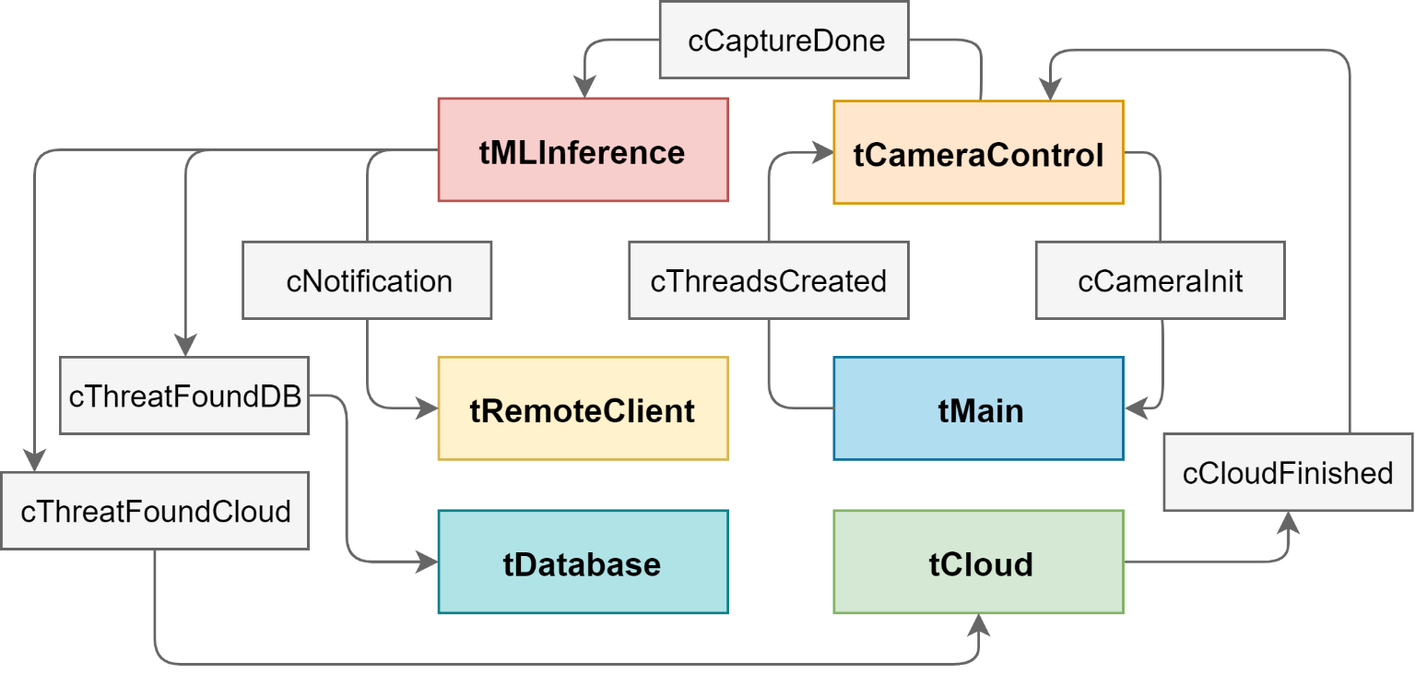
Thread Communication (Condition Variables)

Slide 19
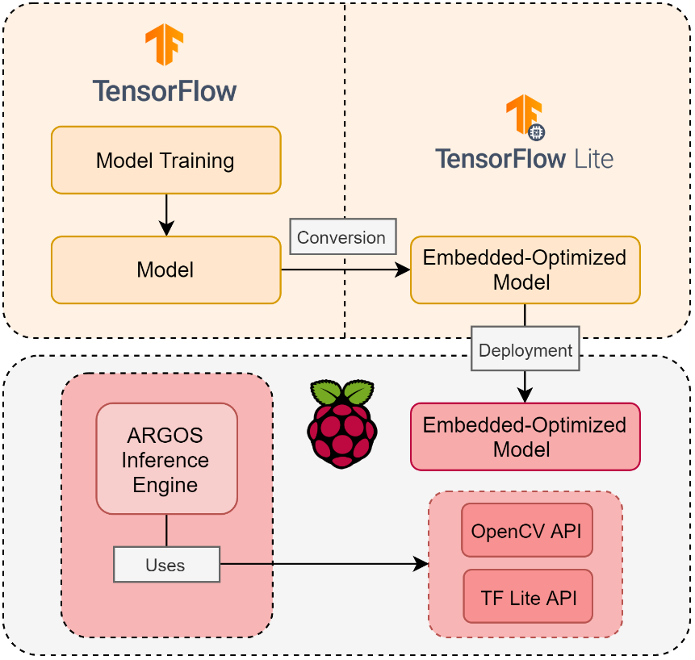
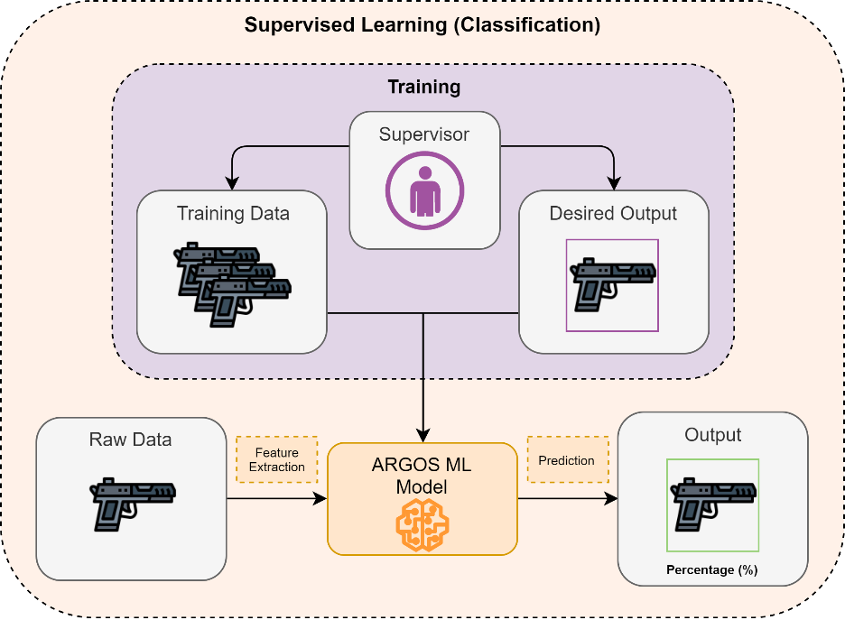
Machine Learning: Overview
Big Picture
Edge ML Framework

Slide 20
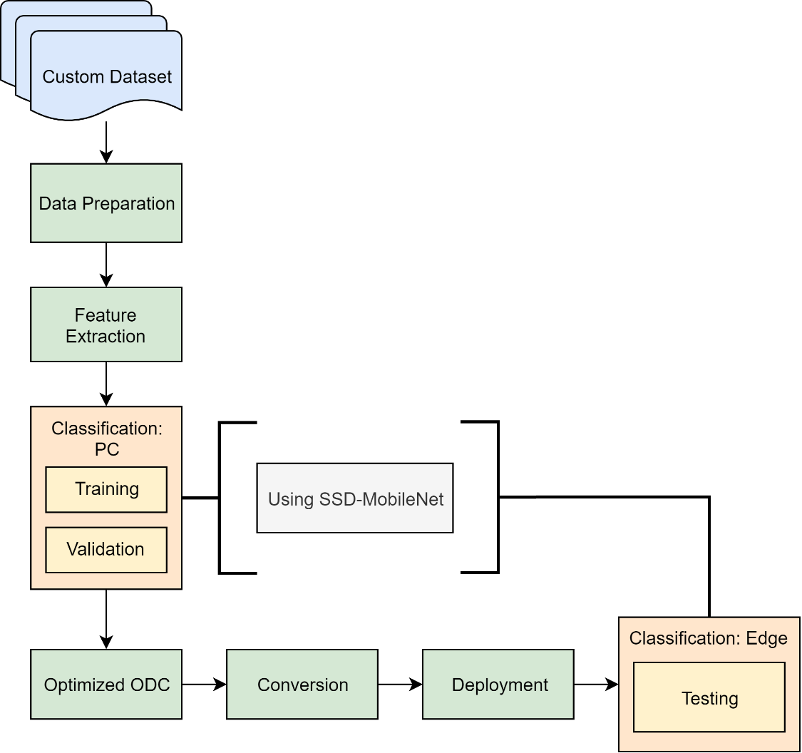
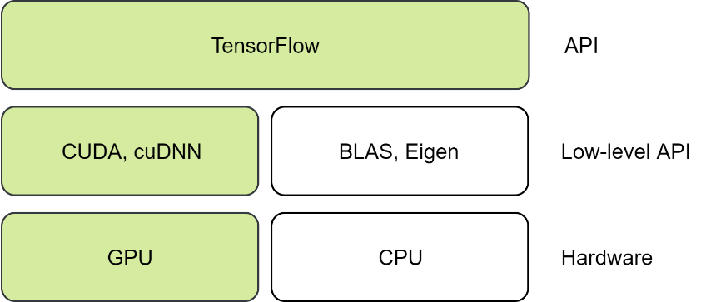
Machine Learning: Guidelines
TensorFlow on the GPU
Machine Learning Flowchart

Slide 21
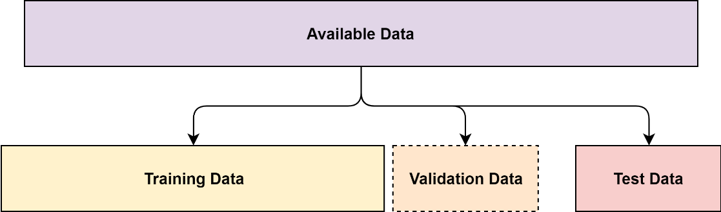
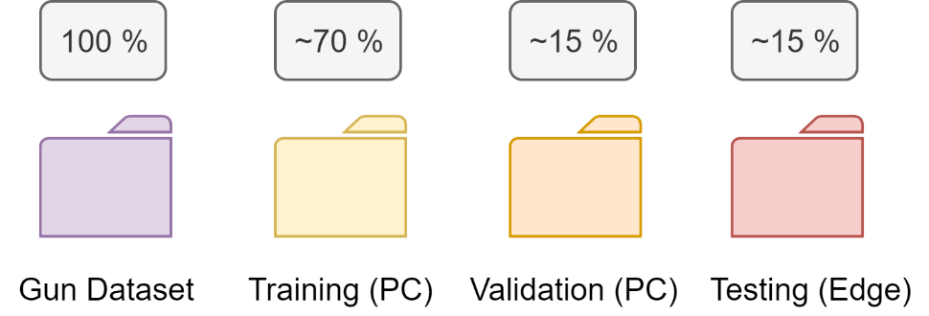
Machine Learning: Dataset Division

Slide 22
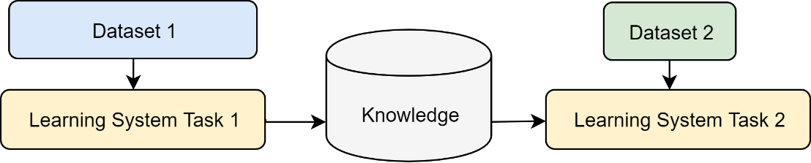
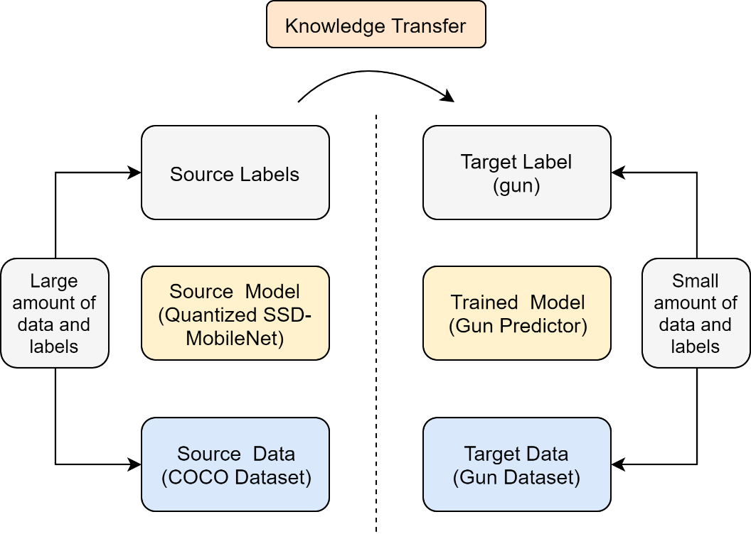
Machine Learning: Transfer Learning
Abstract Scenario
ARGOS Scenario

Slide 23
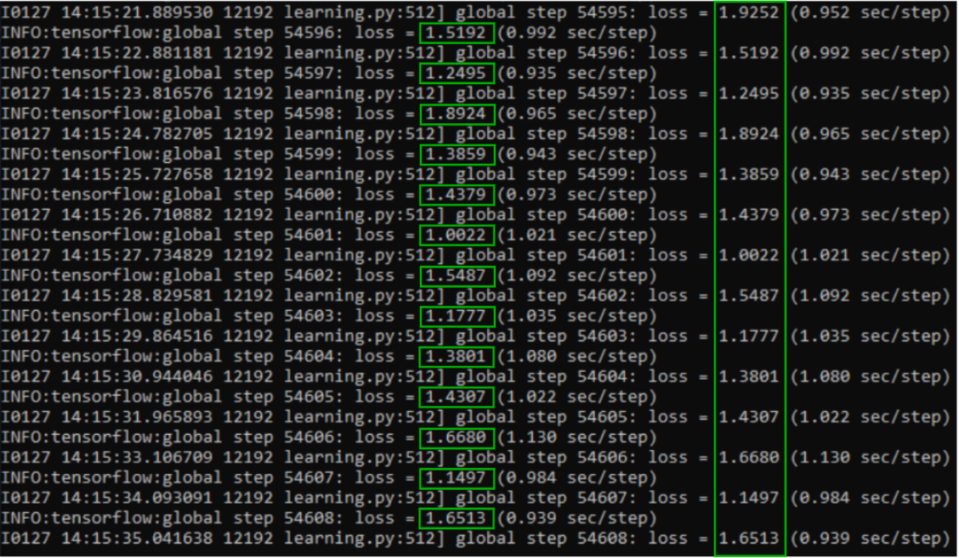
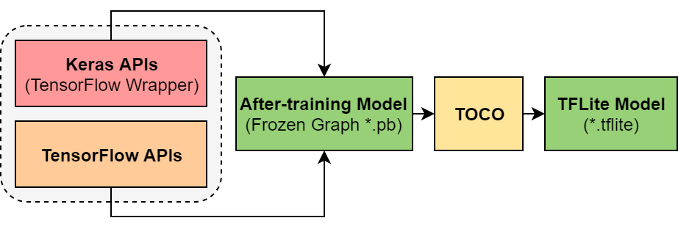
Machine Learning: Model Training & Conversion
Model Training
Model Conversion

Slide 24
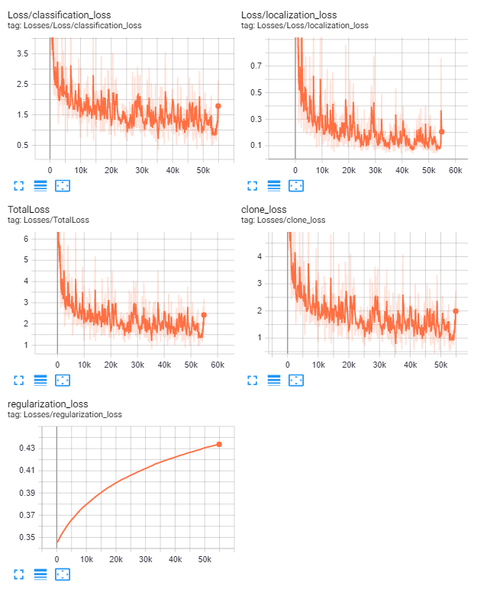
Machine Learning: Loss Graphs

Slide 25
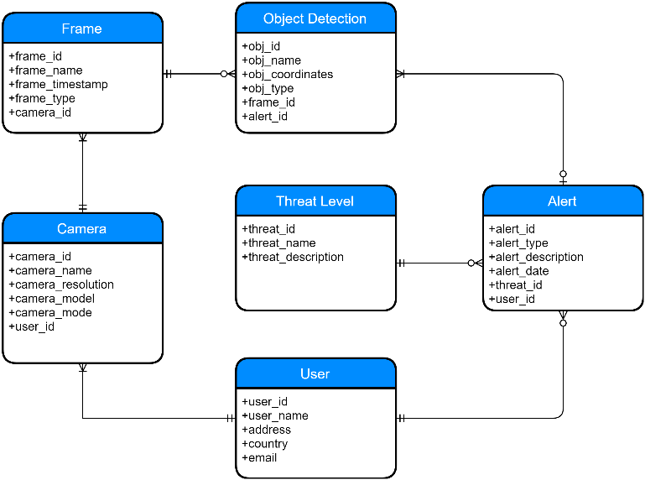
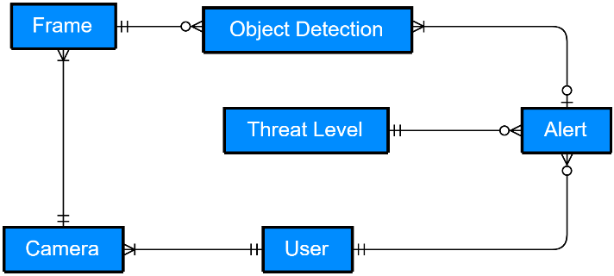
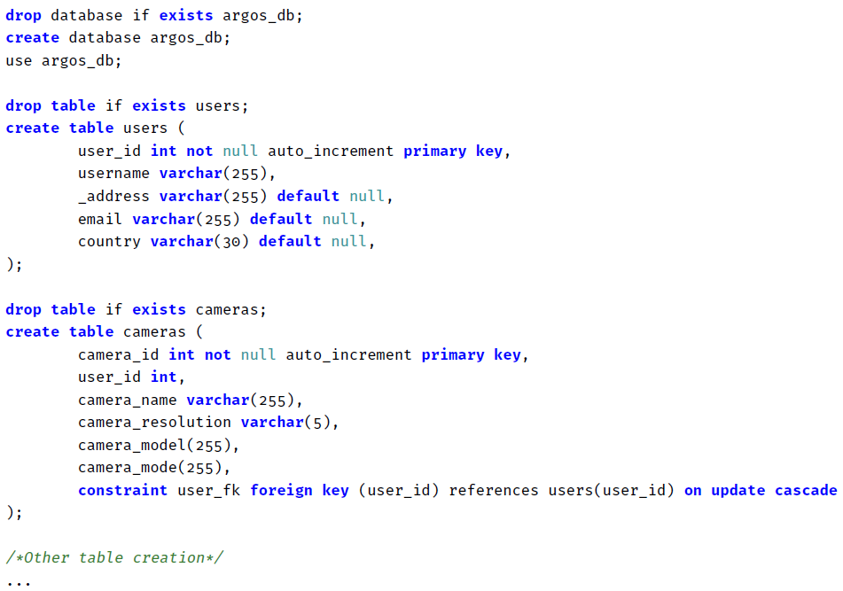
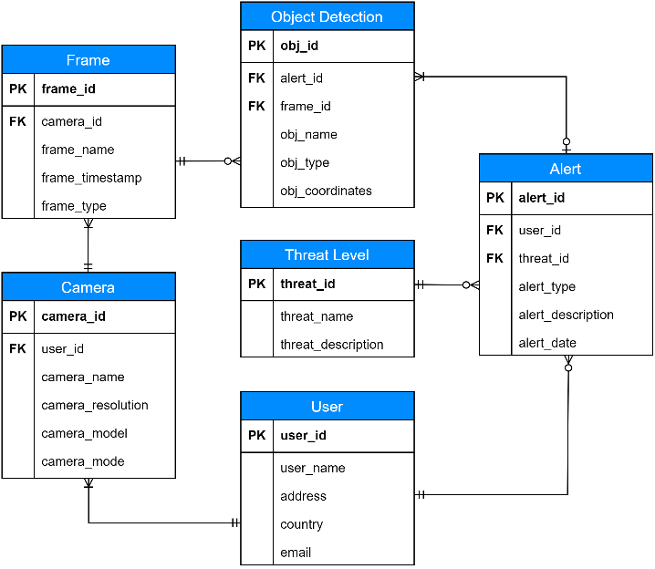
Database: Development Stages
1
Entity Relationship Diagram
2
ER Diagram
4
Implementation
3
ER Logic Diagram

Slide 26
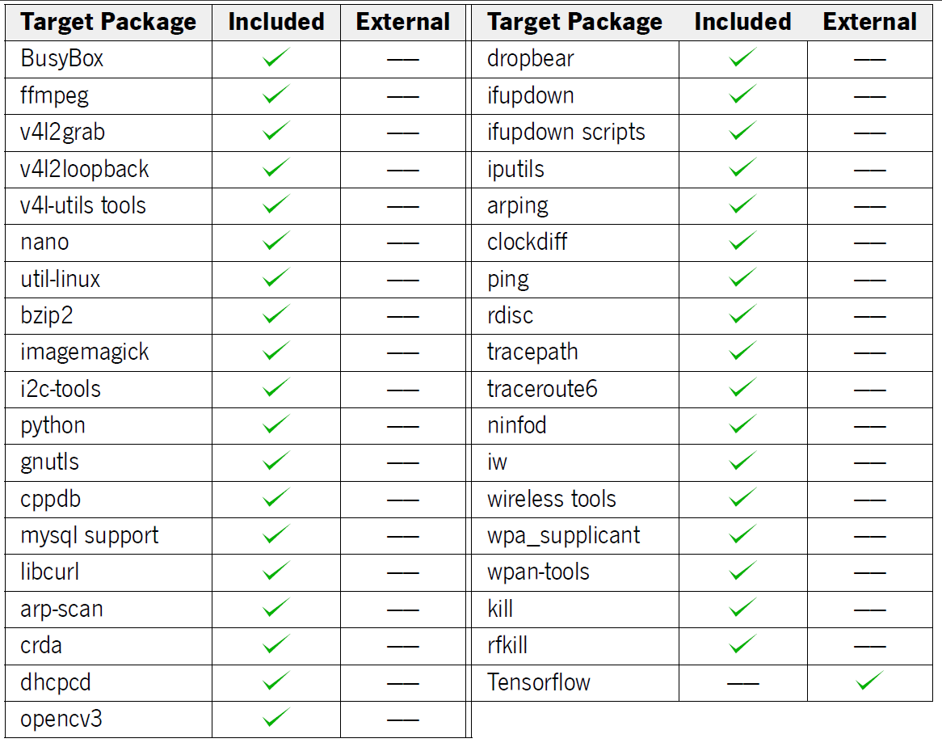
Kernel Image Generation: Packages Overview

Slide 27
Unit Tests: Camera
Camera Setup
Capture Example

Slide 28
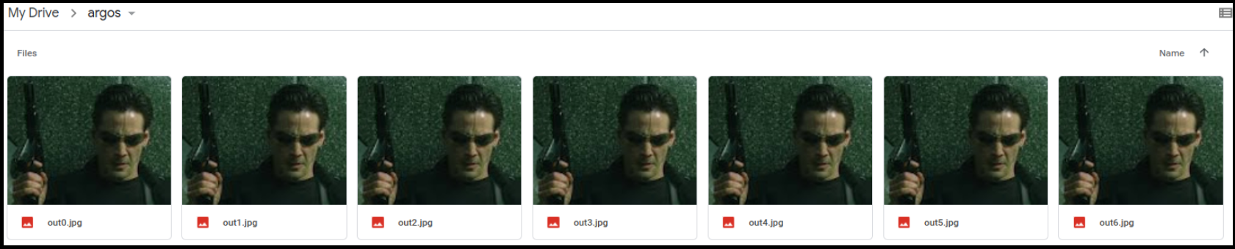
Unit Tests: Local & Cloud Storage
Local Frame Storage
Remote Frame Storage

Slide 29
Unit Tests: Inference

Slide 30
Unit Tests: Daemon & Device Drivers
Daemon Test Example
Device Driver Test Example

Slide 31
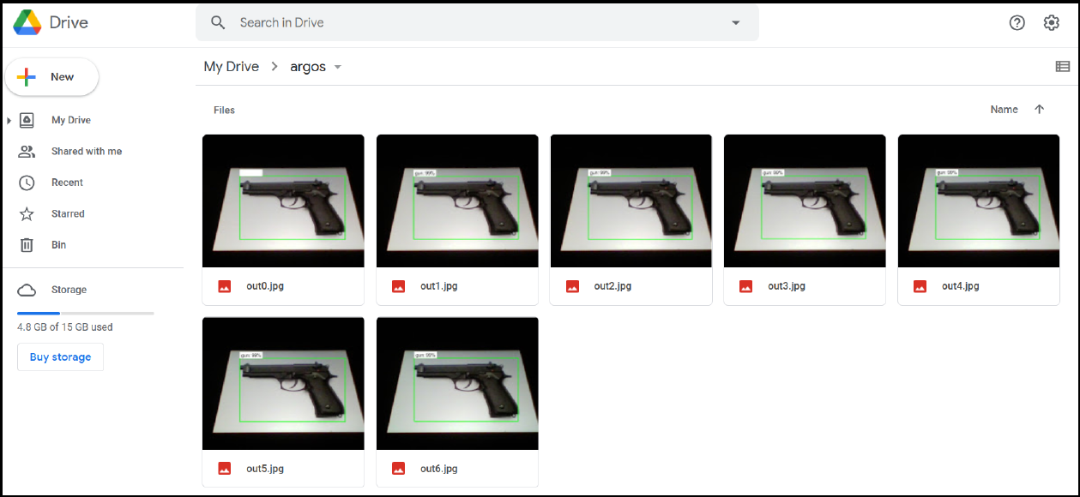
Integration Tests

Slide 32
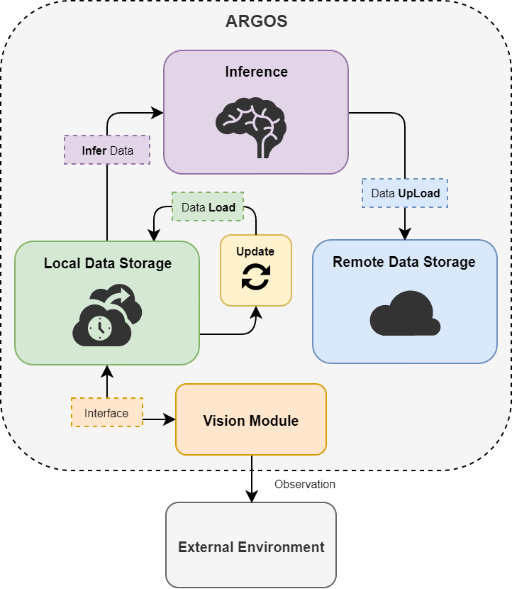
Final Storage Framework

Slide 33
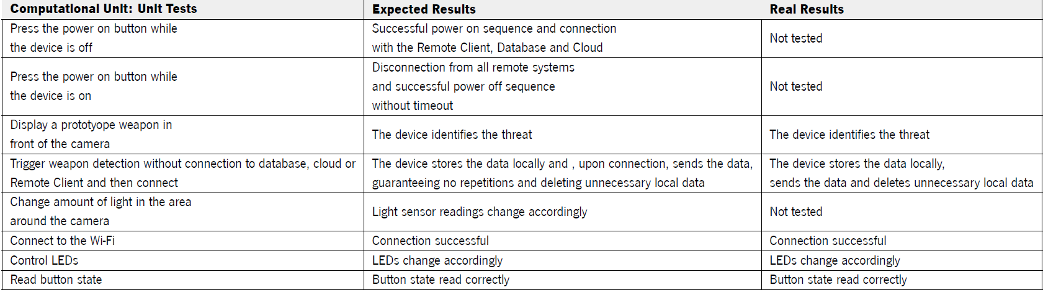
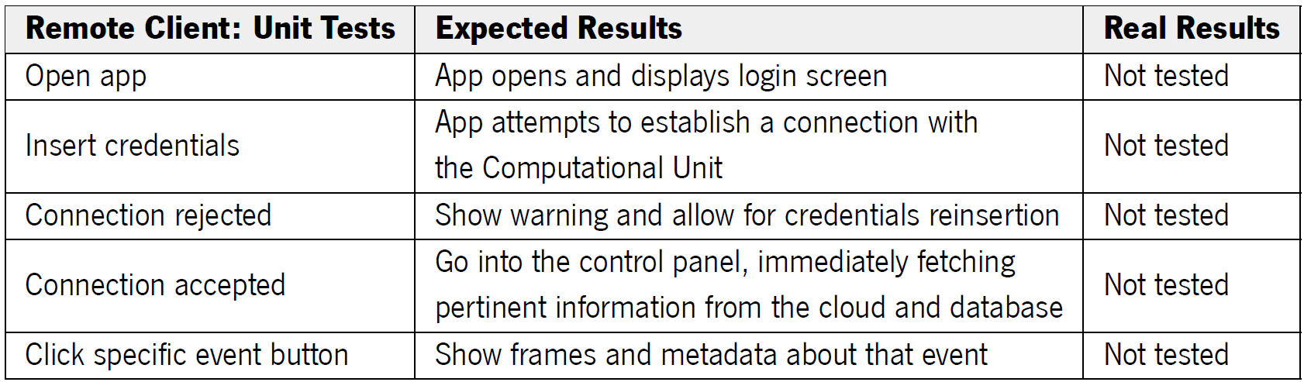
Test Results: Unit Tests
Computational Unit
Remote Client

Slide 34
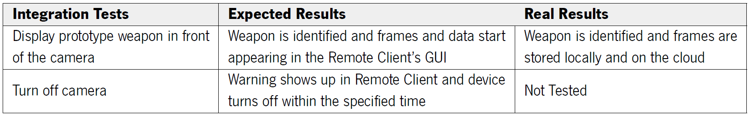
Test Results: Integration Tests

Slide 35
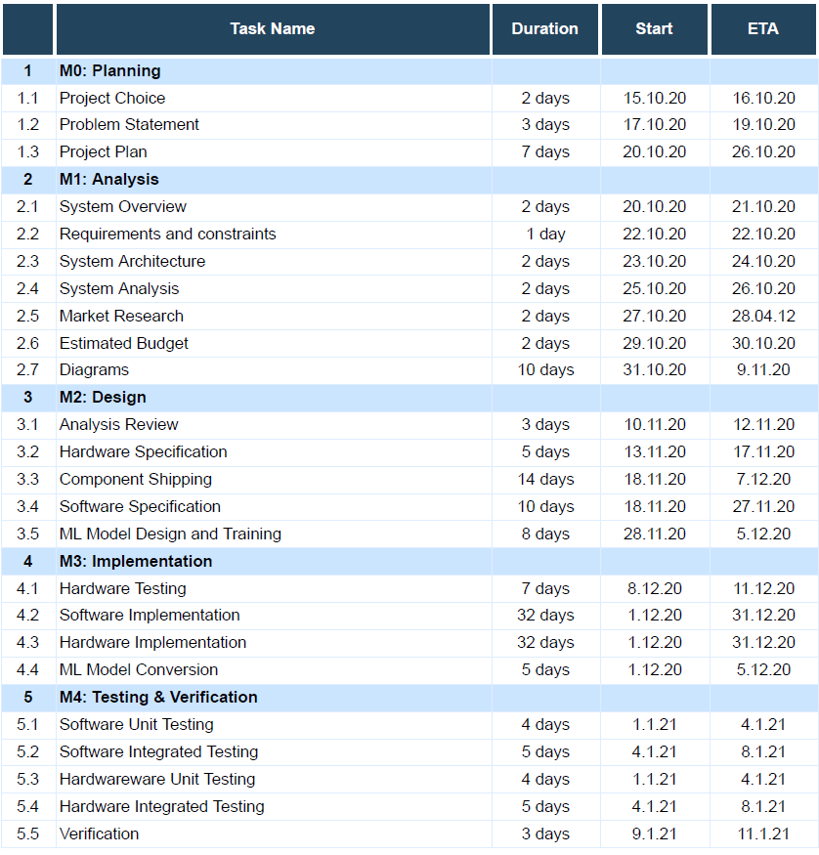
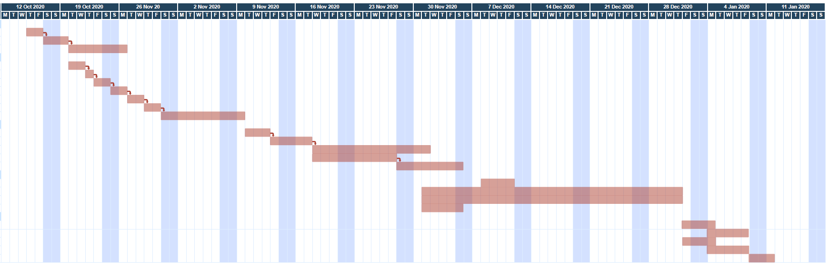
Gantt Diagram

